Slide 1
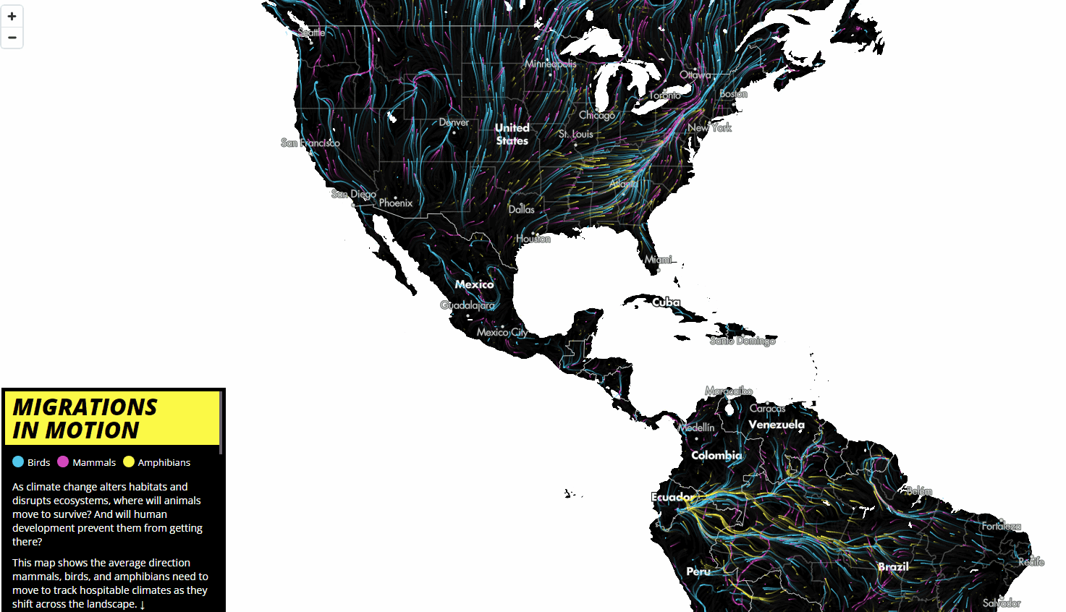
Interactive Maps ENVS456 – week 4 Gabriele Filomena
Source: https://www.maps.tnc.org/migrations-in-motion

Slide 2
Agenda
Interactivity
Interactive (Web) Maps
Interactivity building blocks

Slide 3
Design Principles
Legibility: Maps should be clear and straightforward
Accuracy: maps should be a consistent representation of reality.
Aesthetic Appeal: visually engage the audience
Important: Sourcing
Notes:
Legibility depends on many decisions, such as the scale of the data, and good graphic design.
Not just that features should be in the correct location,
Ref data sources, include a legend defining the classification.

Slide 4
Interactivity

Slide 5
Interactivity: What
Ability to dynamically modify a visualisation
Action/response as part of the experience
“[…] two-way flow of information, […] responding immediately to the latter’s [user’s] input” (Oxford English Dictionary)
Notes:
WHAT YOU SEE IT’S NOT EVERYTHING, MORE THINGS TO UNCOVER
No waiting - responsiveness

Slide 6
Interactivity: Why
Munzner, 2014:
Handle complexity.
Cause the view to change.
Support investigation at multiple levels of detail.
Expand the capabilities of vis (many idioms depend on it).
Notes:
Very complex patterns. Not only fancy

Slide 7
Interactivity: When
Too much to visualise all at once
Both “big picture” and “detail” matter
“[when] seeing the dataset structure in detail is better than seeing only a brief summary of it” Munzner (2014)
Notes:
Dataset too big

Slide 8
Interactive (Web) Maps

Slide 9
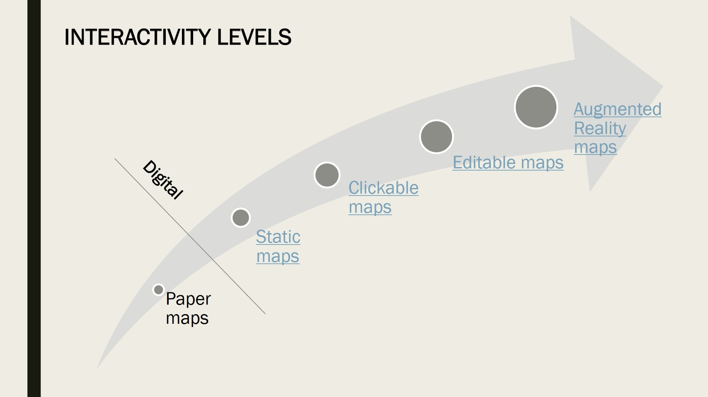
Interactive (Web) Maps
Image: A. Calafiore

Slide 10
Interactive (Web) Maps
Efficient medium for high information throughput (Tufte)
Maps as “windows” into large datasets
“A map of many maps”
Notes:
Rearrange information

Slide 11
Interactivity Building Blocks

Slide 12
Interactivity Building Blocks
Filtering
Pan
Zoom
Subset
Perspectives/Volumes
Tooltips
Split
Animate

Slide 13
Filtering
Widely used design choice in visualisation Reduction of the set of elements being displayed Discard geographically or attribute-based

Slide 14
Filtering: Pan
What: Travels within a single scale
Use: Segment a map geographically
Abuse: Map is meant to focus on just a single region

Slide 15
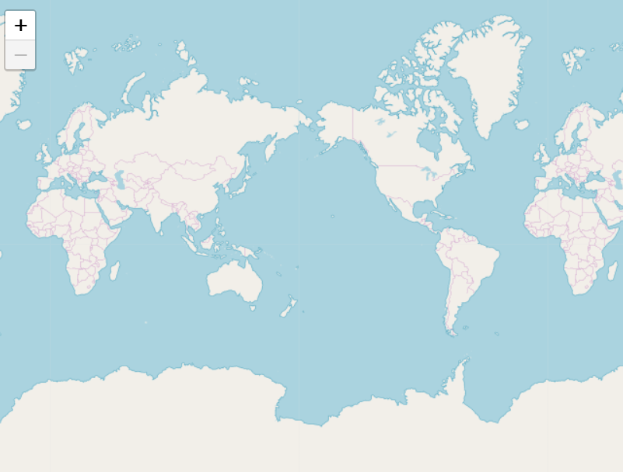
Filtering: Zoom
What: “Travel” across scales
Use: Present different degree of detail
Abuse: Focus is on the global pattern

Slide 16
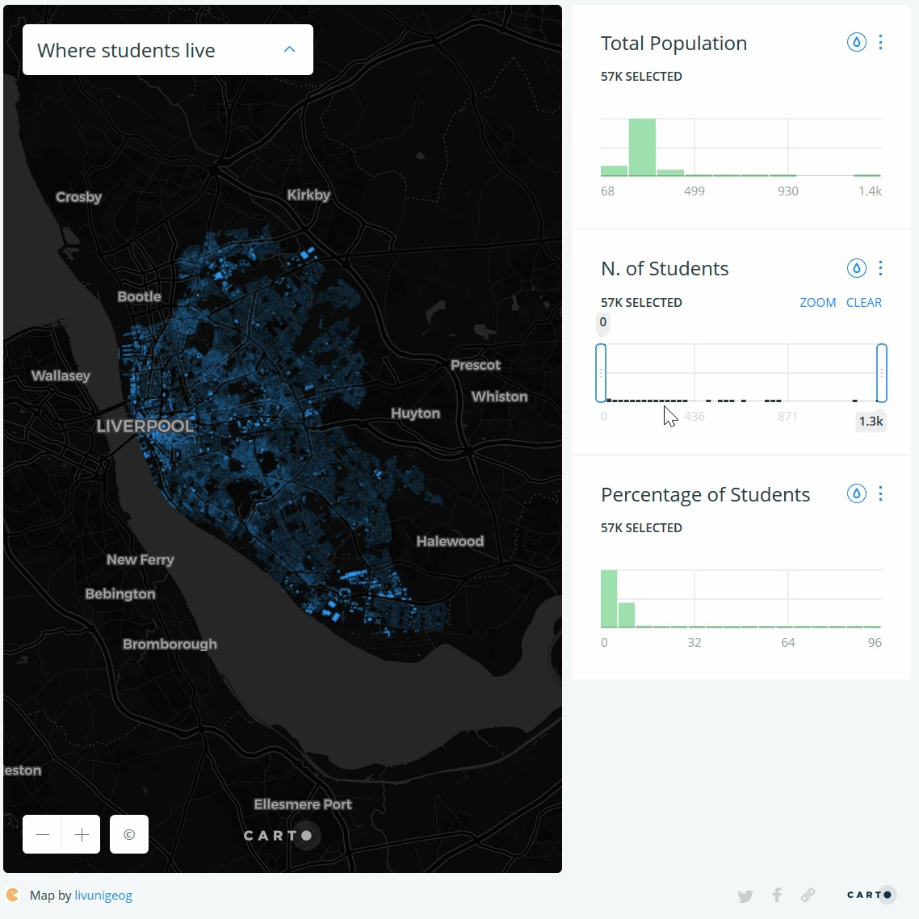
Filtering: Subset
What: Restrict data showed (by attribute)
Use: Explore patterns by value or category
Abuse: Focus is on the global pattern

Slide 17
Volumes/Perspectives
What: Add a 3rd dimension (or a 2.5d)
Use: Volumes or perspectives are relevant
Abuse: Any other case

Slide 18
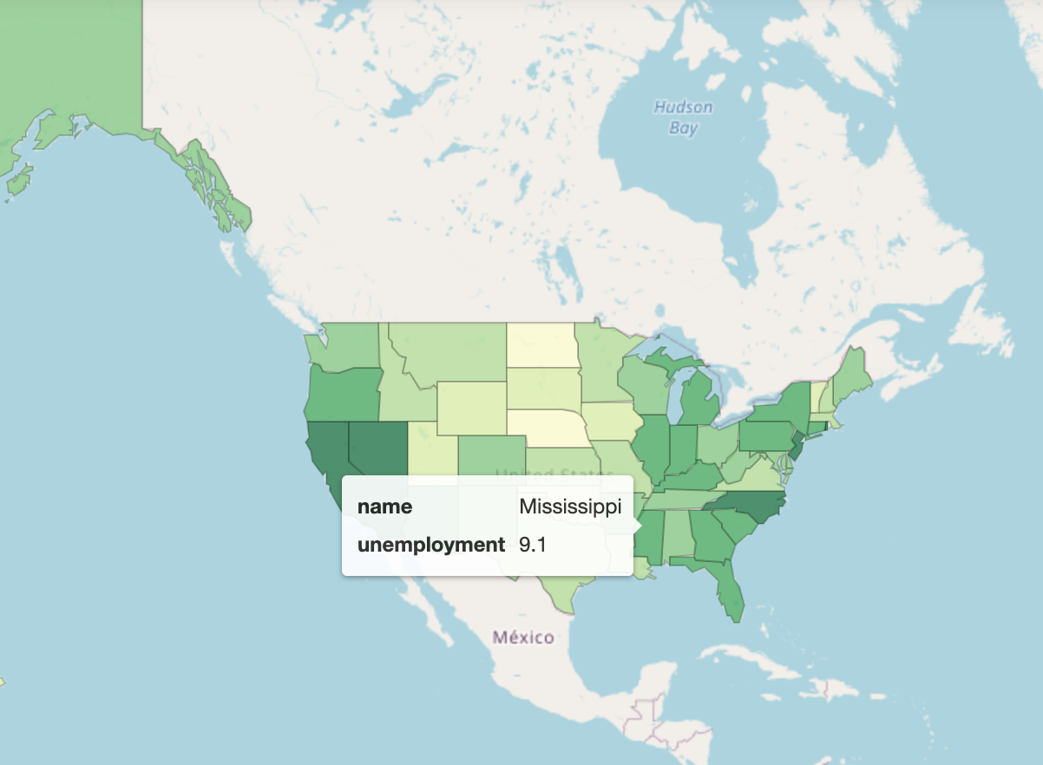
Tooltips
What: Contextual (non-geo) information, on demand
Use: Let the user explore the feature’s attributes
Abuse: Include too much data in the tooltip.

Slide 19
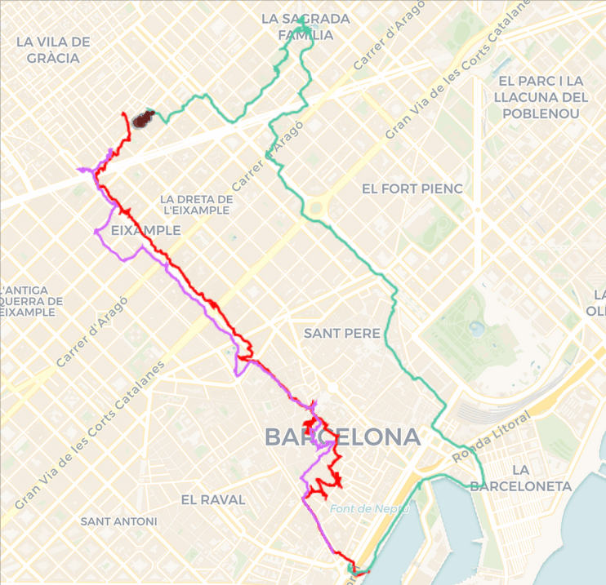
Animate
What: Add temporal dimension through compilation of slices
Use: Explore space-time Patterns
Abuse: Communicate cross-sectional insights

Slide 20
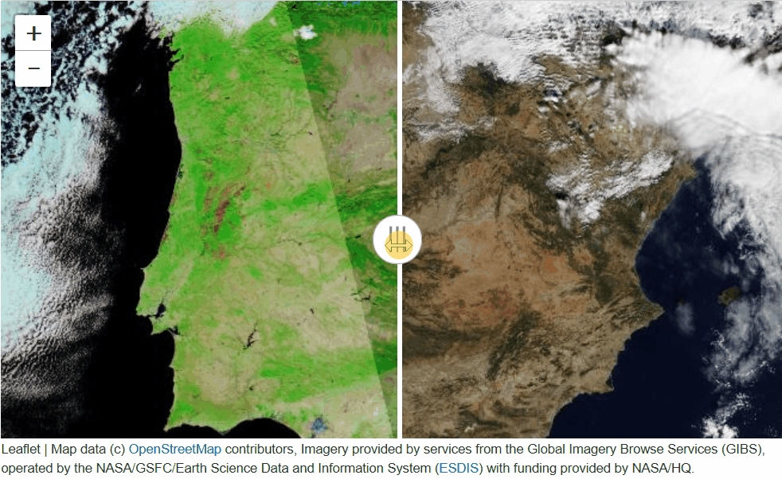
Split
What: Overlay two maps of the same location
Use: Compare pattern changes
Abuse: When you need to see the same location in both maps

Slide 21
General tips
Think about the experience first, then consider the technology.
Avoid feature overload.
Interactivity is not binary.

Slide 22
Let’s talk about Assignment I

Slide 23
References
Tamara, Munzner. Visualization Analysis and Design. CRC Press, 2014

